Slide 1
Study Assistant AI-Powered Study Companion
Your Personal AI Tutor for Smarter Learning
Name: Roshini Senbaga T K
Date : 10-04-2026
Weblink: https://id-preview--848b490f-3049-4d29-b0ac-d2dd1e5bc855.lovable.app

Slide 2

Why Students Need a Better Way to Study
Overwhelming study material & lack of personalized guidance
Difficulty in understanding complex concepts
Time-consuming note-making and revision
No real-time doubt clearing or progress tracking
Traditional methods are passive and one-size-fits-all

Slide 3
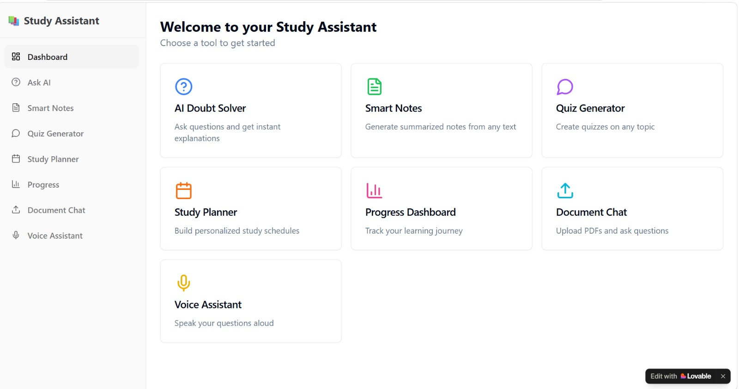
Introducing Study Assistant
“One app. All your study needs. Powered by AI.”
Intuitive interface with 8 powerful features

Slide 4
Feature Highlights
AI Doubt Solver
Smart Notes Generator
AI Quiz Generator
Personalized Study Planner
Progress Dashboard .
Document Chat .
Voice Study Assistant

Slide 5
Modular Architecture
Module | Core Responsibility | Key Features
1. AI Doubt Solver | All AI interactions | Doubt Solver, Document Chat, Voice Assistant, Concept explanations
2. Smart Notes Generator | Study material management | Smart Notes, PDF upload, Highlighting, Mind maps
3. AI Quiz Generator | Testing & practice | AI Quiz Generator, Flashcards, Timed quizzes
4. Personalized Study Planner | Time & focus management | Study Planner, Focus timer, Reminders
5. Progress Dashboard | Performance tracking | Progress Dashboard, Topic mastery, Reports
6.Document chat | Interactive Q&A with uploaded documents | PDF upload, ask questions about content, summarize concepts, extract explanations, chat with any study material
7. Voice study Assistsant | Hands-free voice-based learning support | Voice input (speak questions), natural real-time responses, speech-to-text + text fallback, study-focused explanation

Slide 6
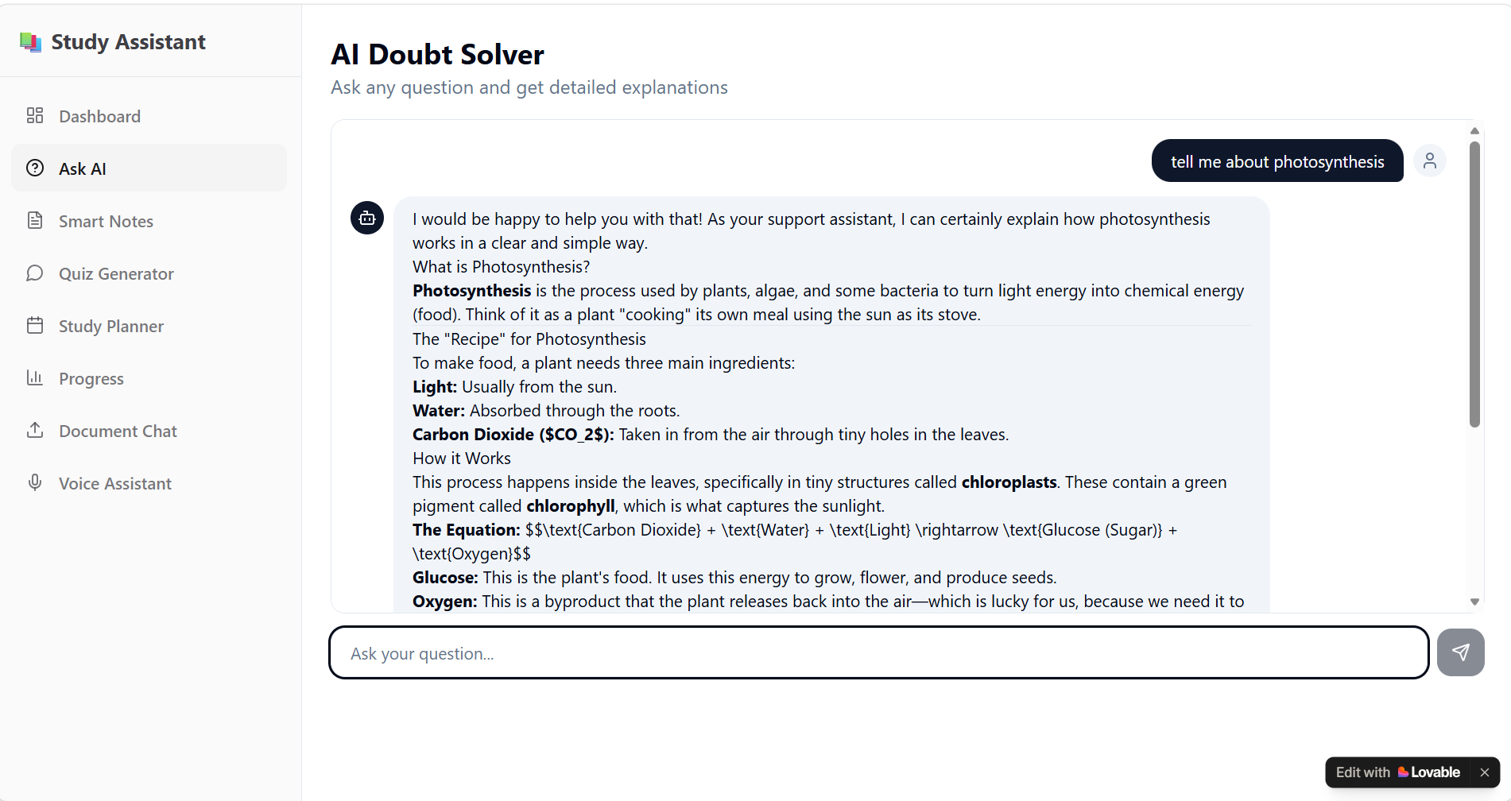
AI Doubt Solver
Ask any question → Get instant, detailed explanations with equations & diagrams
Real-time AI tutor that explains concepts clearly
Supports complex topics with step-by-step breakdowns
Example: “Tell me about photosynthesis” → Full answer with equation

Slide 7
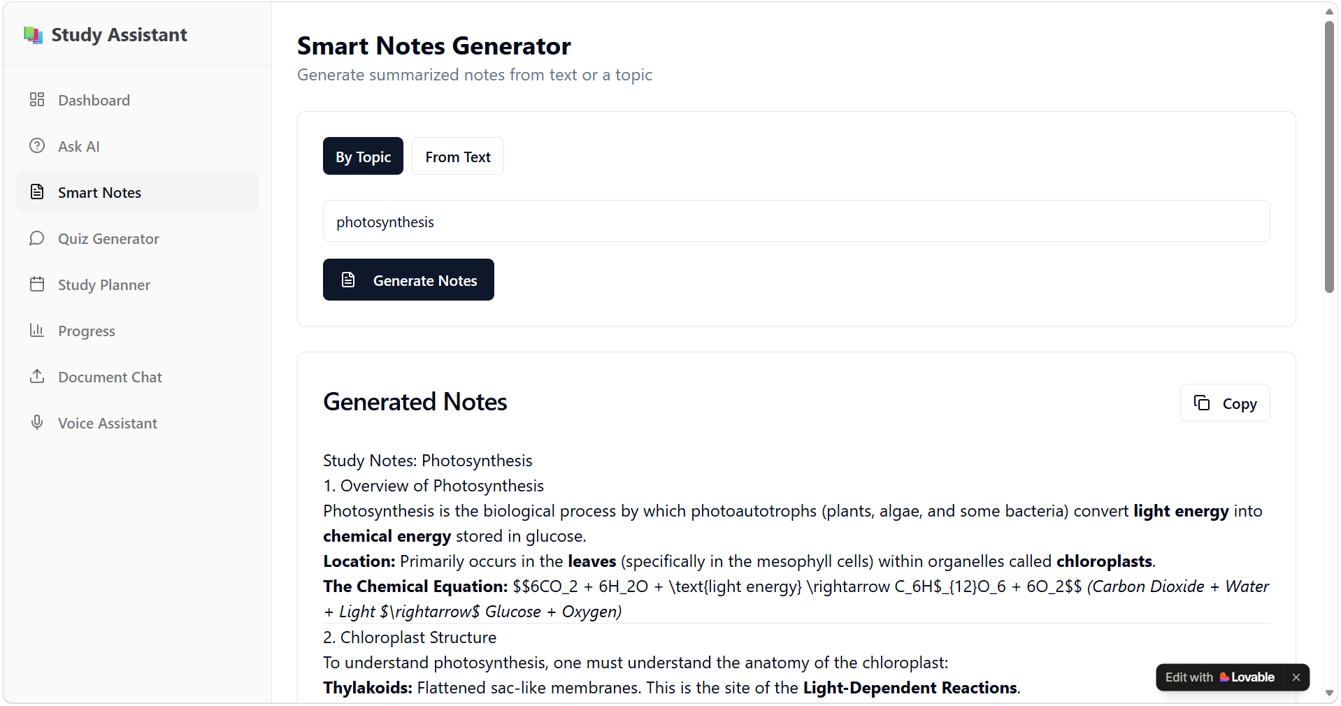
Smart Notes Generator
Turn any topic into beautiful, structured study notes in one click
Summarizes long text or topics instantly
Perfectly organized with headings, bullet points & equations
Ready-to-revise notes that save hours of manual work

Slide 8
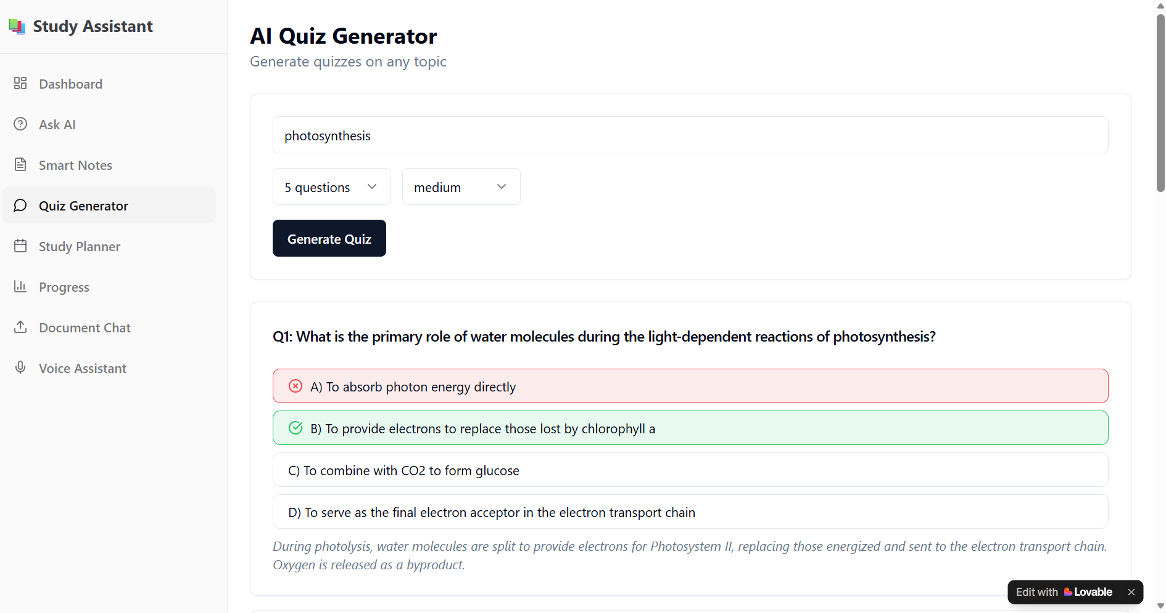
AI Quiz Generator
Instant quizzes with instant feedback & explanations
Test your understanding on any topic.
Shows correct answers with why they are right.

Slide 9
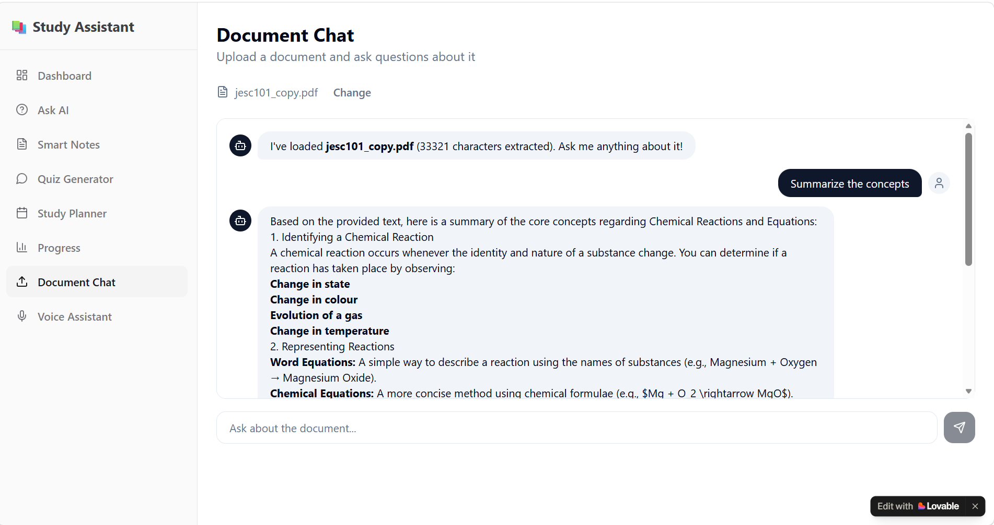
Document Chat
Upload any PDF → Chat with your document like a tutor
Ask questions about uploaded notes or textbooks
Get summaries, explanations, and key concepts instantly

Slide 10
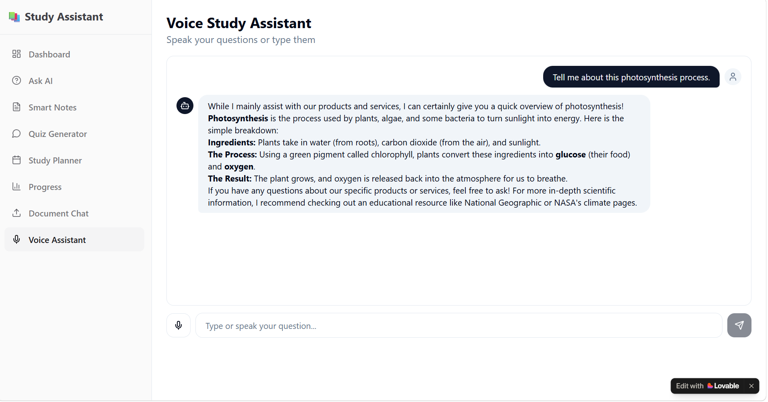
Voice Study Assistant
Speak your doubts → AI replies naturally
Hands-free learning experience
Voice input with text fallback
Perfect for revision while walking or commuting

Slide 11
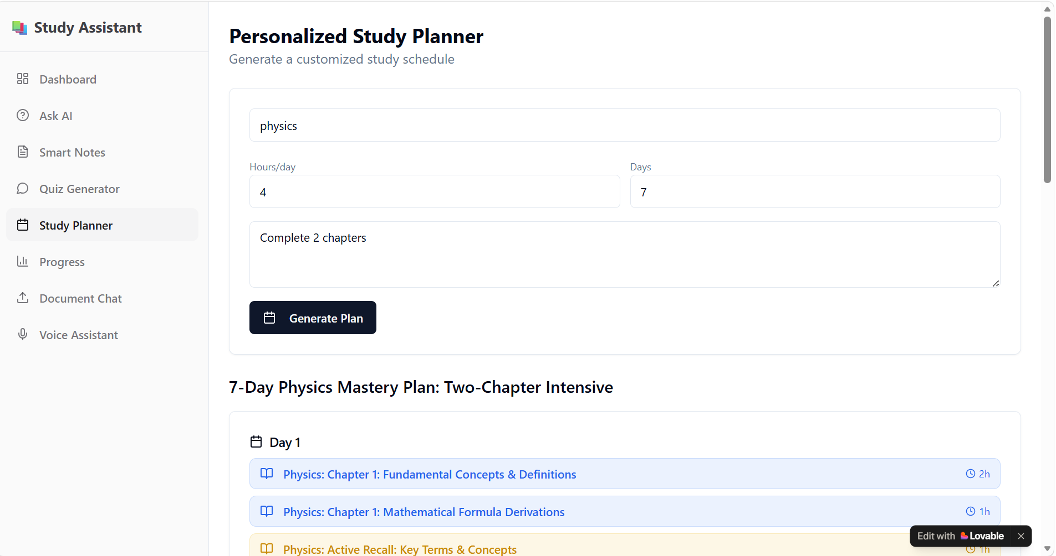
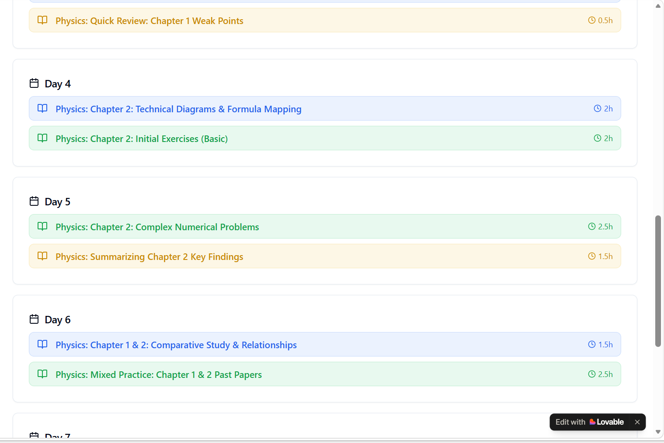
Study Planner + Progress Dashboard
Build custom study schedules and track your learning journey
Daily/weekly personalized timetables
Visual progress tracking
Topic-wise mastery analytics

Slide 12
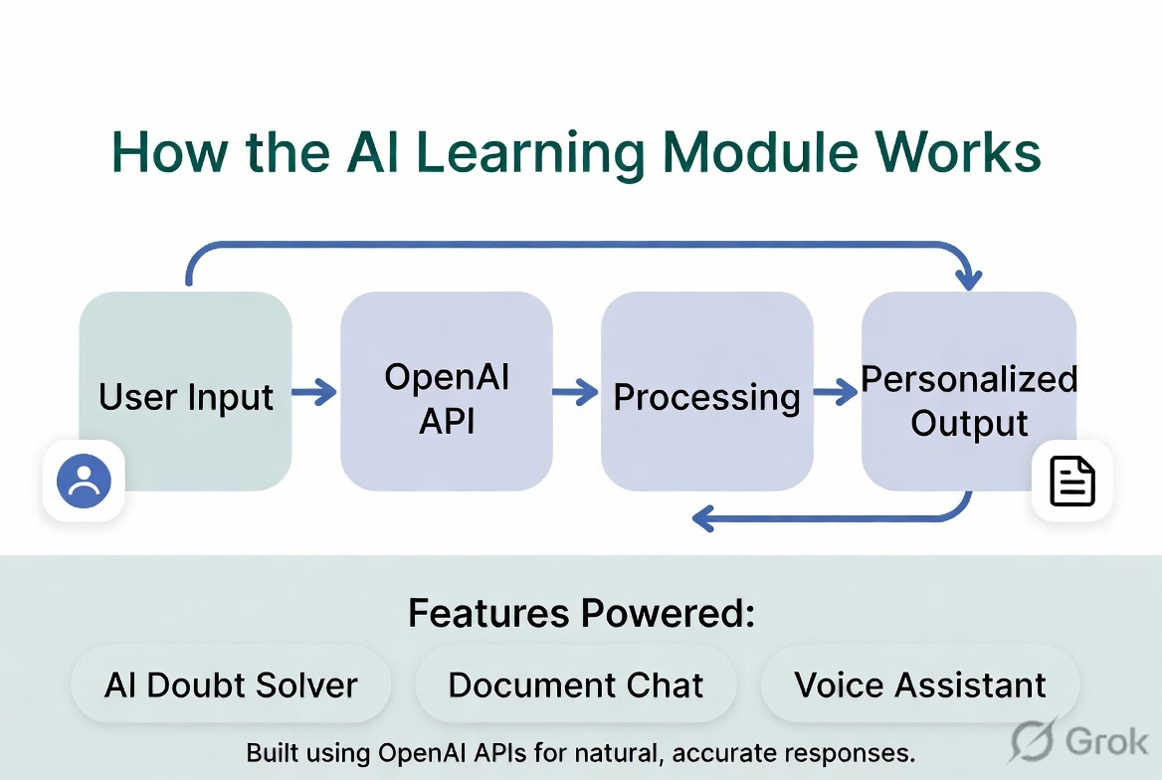
Flow diagram
Built using OpenAI APIs for natural, accurate responses

Slide 13
Why Study Assistant Stands Out
24/7 instant doubt clearing
Saves hours on note-making and revision
Adaptive learning path based on student performance
Makes learning interactive and engaging
Works on any device (web app)
Perfect for CBSE, JEE, NEET & school students

Slide 14
Roadmap Ahead
Mobile App (Android & iOS)
Advanced Mind Map & Flashcard generation
Integration with school/college syllabus
Offline mode
Parent dashboard & analytics sharing
Multi-language support (Hindi + English)

Slide 15
Thank You
Ready to revolutionize the way India studies?
https://id-preview--848b490f-3049-4d29-b0ac-d2dd1e5bc855.lovable.app
Contact : Roshini@hexaware.com
Built with ❤️ for students by Roshini

